Slide 1

Sampling
DATA ANALYTICS | IRONHACK

Slide 2

IRONHACK BOOTCAMP
POPULATIONS AND SAMPLES
A population is a COMPLETE collection of items/individuals/products
A sample is SUBSET of a population
Population
Sample

Slide 3
IRONHACK BOOTCAMP
SAMPLING POPULATIONS
Gather a whole population usually impossible.
It will be computationally prohibitive to train a model with the whole population. What’s more, why you want to make predictions if you have the whole population? You already know the answer!
When sampling we need to put special care in how we pick our samples to prevent biasing our data set and therefore our model.

Slide 4
IRONHACK BOOTCAMP
REPLACEMENT
Would you like to collect the same item several times or only once?
Yes -> Do replacement
No - > Don’t do replacement

Slide 5
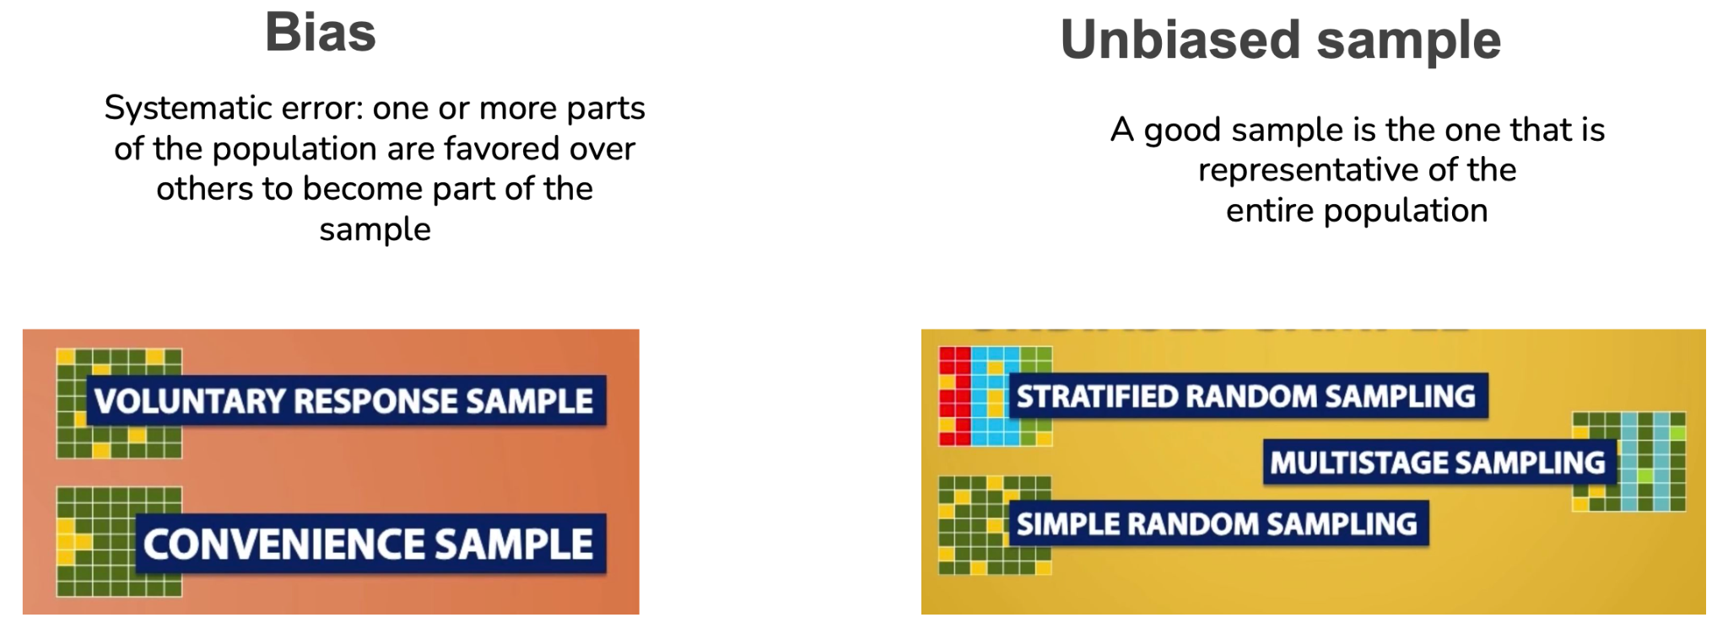
IRONHACK BOOTCAMP
SAMPLING METHODS

Slide 6
IRONHACK BOOTCAMP
BIASED SAMPLING METHODS
Voluntary response sample:
Not all the relevant individuals will answer, therefore some important sectors of the population can be missing.
Convenience sampling:
I only collect what I want, not the reality ( electoral polls )

Slide 7
IRONHACK BOOTCAMP
OTHER SAMPLING METHODS TO AVOID:
Cherry picking: selecting the samples that fit your claim
Data dreiding: repeating the experiment until with the same data until you validate your hypothesis
Survivor bias: fixing your attention on a subset of the data
Cobra effect: promoting the sample you want
False causality: assume that two independent events are causally related.
Gambler’s fallacy: assume that as something appeared quite often it will not appear more.
Observer effect: the observer affects the outcome of the experiment
Fallacies

Slide 8
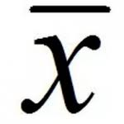
IRONHACK BOOTCAMP
COMMON STATISTICS NOTATION
POPULATION PARAMETERS:
N: Number of elements in the population
μ: mean of the population
𝜎: standard deviation of the population
SAMPLE STATISTICS: ( they are random by nature )
n: Number of elements in the sample
: : sample mean
S: sample standard deviation

Slide 9
IRONHACK BOOTCAMP
EXPERIMENT
A procedure that can be repeated many times with defined outcomes:
Random: multiple possible outcomes
Deterministic: one possible outcome

Slide 10
HOW TO CHARACTERIZE A SAMPLE/POPULATION
There are two types of measures to characterize a sample / population
Central tendency
Dispersion

Slide 11
IRONHACK BOOTCAMP
MEASURES OF CENTRAL TENDENCY
[1,2,2,4,6,8,50]
Mean: (1+2+2+4+6+8+50)/7 = 10.43 ( heavily affected by outliers)
Median: 4 ( unaffected by outliers )
Mode: 2

Slide 12
IRONHACK BOOTCAMP
MEASURES OF DISPERSION
Residuals: ( real - predicted )
Variance: sum of squared residuals divided by n - 1
Standard deviation: root square of variance
Range: difference between the maximum and minimum
Percentile: the value such P percent takes this value or less
Interquartile range: difference between percentiles 75% and 25%

Slide 13
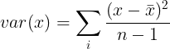
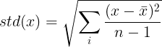
IRONHACK BOOTCAMP
VARIANCE AND STANDARD DEVIATION
Variance:
Standard deviation:
(we divide by n-1 to
avoid underestimating the
Standard deviation)
demo

Slide 14
IRONHACK BOOTCAMP
QUANTILES AND IQR
The quantiles of a sample are defined in the following way:
Q1: after sorting the values from the smallest to the highest, which value is bigger 25% of the total values:
Q2: after sorting the values from the smallest to the highest, which value is bigger 50% of the total values:
Q3: after sorting the values from the smallest to the highest, which value is bigger 75% of the total values:
The IQR = Q3 - Q1 is called the “interquartile range”

Slide 15
IRONHACK BOOTCAMP
TRANSFORMING DATA: TRANSFORMERS
Collected data can be affected by:
Outliers
Small range
Skewness
All those problems will affect the predictive power of your model
You will need to transform the data to:
Improve interpretability
Declutter graphs
Discover relationships between variables

Slide 16
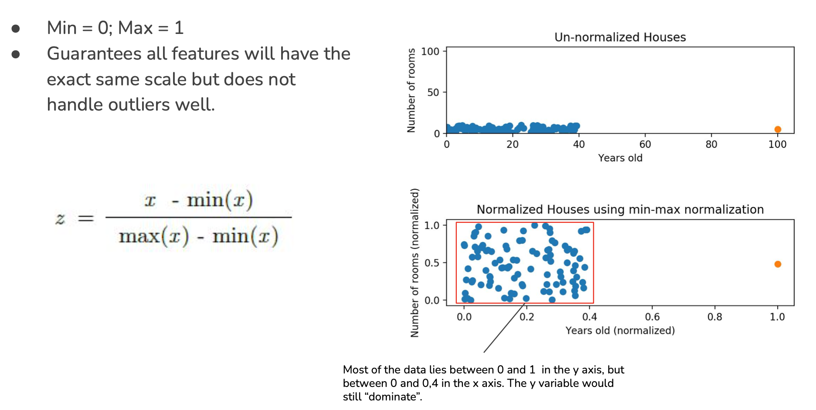
IRONHACK BOOTCAMP
MIN-MAX TRANSFORMER:
MinMaxScaler

Slide 17
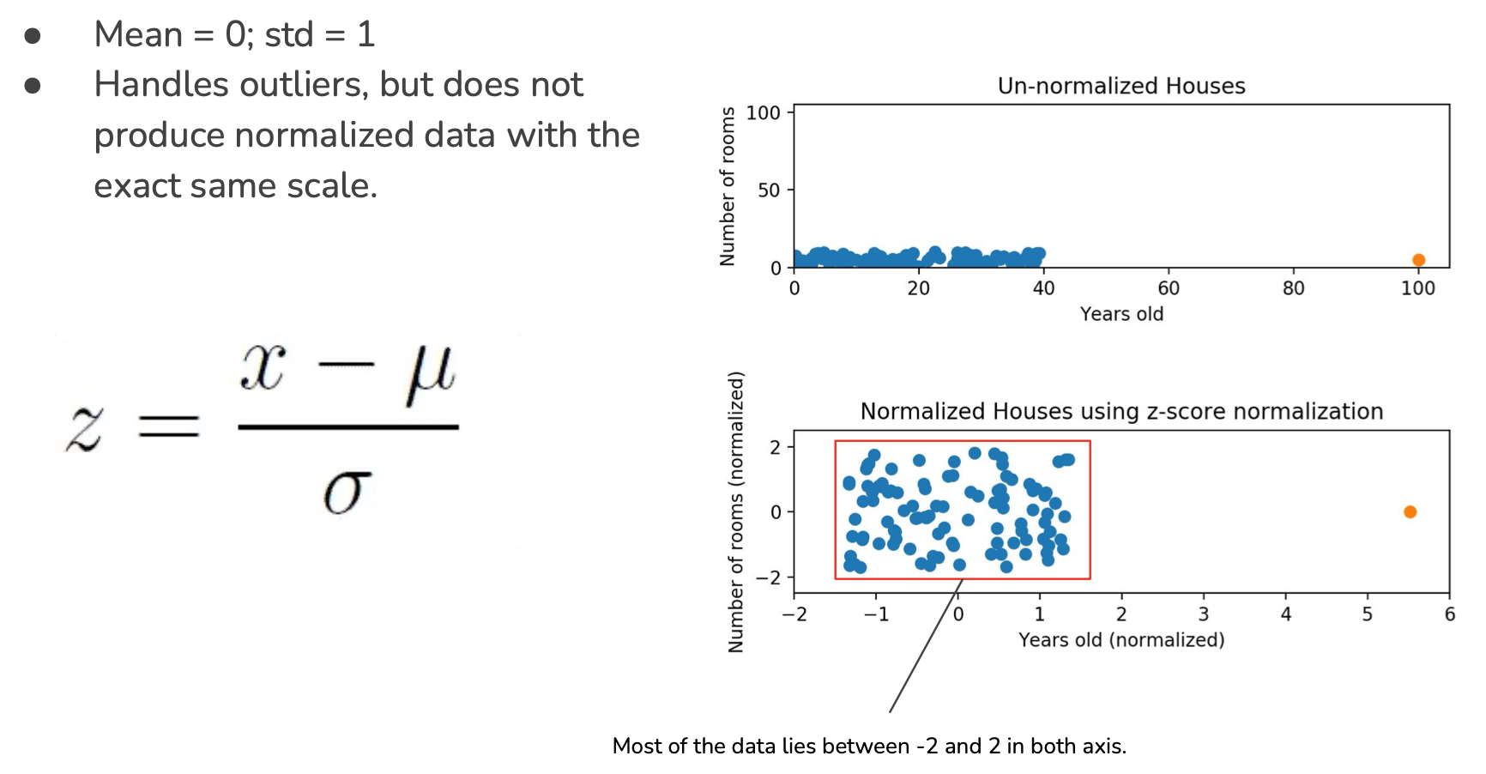
IRONHACK BOOTCAMP
STANDARDSCALER TRANSFORMER:
StandardScaler

Slide 18
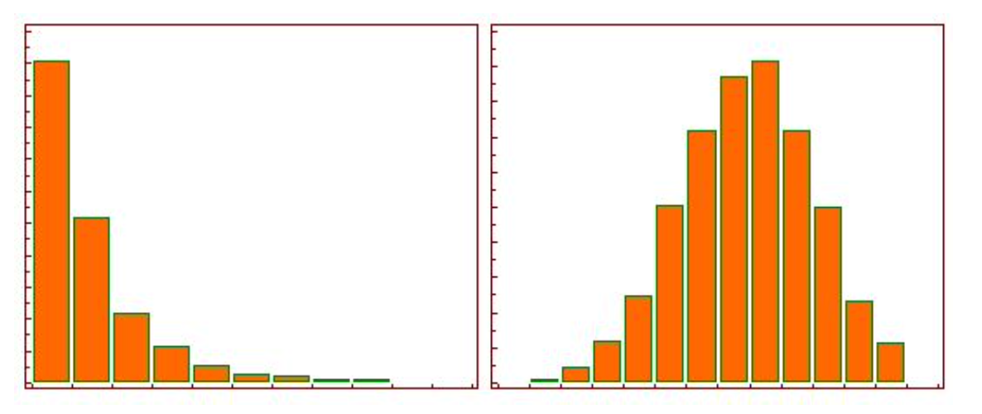
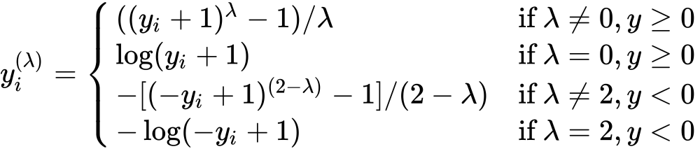
IRONHACK BOOTCAMP
POWER TRANSFORMER:
PowerTransformer
Replaces the values in each column in order to end up with a new distribution with the smallest skewness.
Depends on a parameter called “lambda” to be determined for each sample.

Slide 19


